Slide 1
Software Tools
Human Computer Interaction

Slide 2


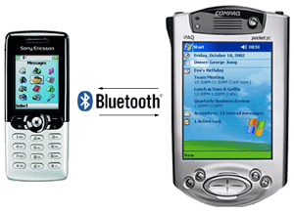
Introduction
User-Interface Architects
Similar to Building Architects
UI Jobs (even domain specific!)
Ideal: Complete design before starting to build
Multiple designers AND engineers
Sit down and think about what needs to be done
Still design, even though it will change!
Standard GUIs have enabled 50% to 500% productivity gains
Desktop Computer is losing its prominence
More mobile, more distributed
Software must support greater plasticity (ex. resolution)
Display size, telephone access, web access, languages
Device-independent programming

Slide 3
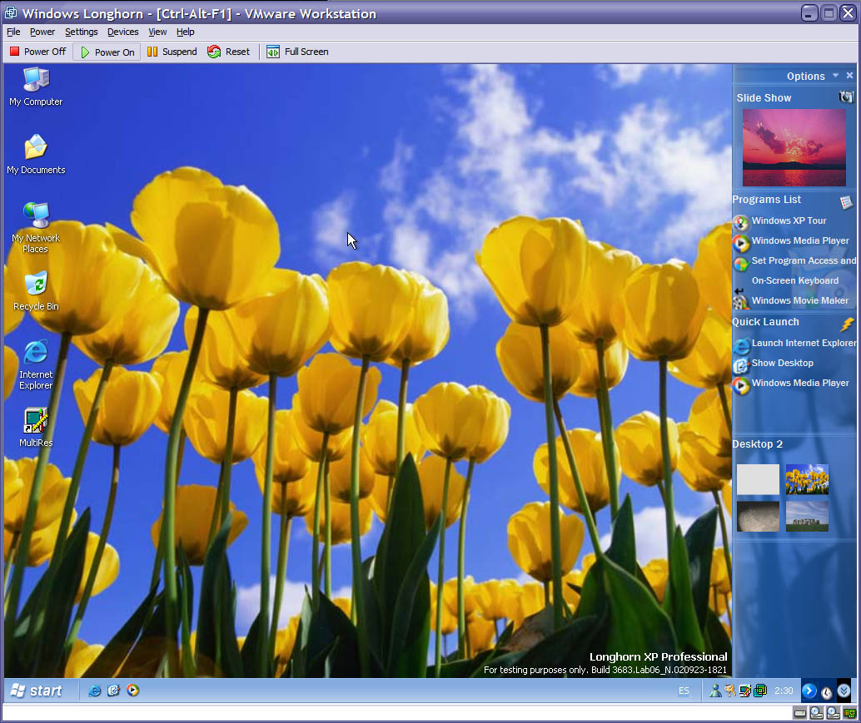
Specification Methods
Goal: How do we specify the GUI
Natural Language
Pros: easy to understand, sketchpad, blackboard
Cons: Lengthy, vague, ambiguous, difficult to prove
Formal and Semiformal languages
Grammars for command languages
Backus-Naur Form – BNF
More difficult for GUIs – usually describe sequence of actions
Transition diagrams
Menu-tree structures
Statecharts
Graphical specifications

Slide 4
Grammars
Specify Textual Commands or Expressions that a program would understand
Still used in spreadsheet calculators
BNF example on pg. 176
Multiparty Grammars
Nonterminals that depict the actor (user/computer) for interactive programs
Text-oriented sequences
Voice Recognition Systems
Pros:
Aspects can be formally written down
Verification of completeness and correctness
Cons:
Doesn’t scale well
Graphics apps still difficult to do

Slide 5
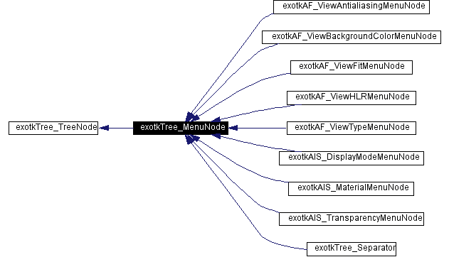
Menu-Selection and Dialog-box
Menu-Selection Tree
Create menus graphically
Tools exist for:
Creation
Design
Pros:
Review
Consistency
Totality
Completeness
Redundancy (examples?)
Cons:
Menu trees often do not show all possible actions (incomplete)
Sometimes menus are not a tree
Example, Ch.7.4
Same thing for dialog-box trees

Slide 6
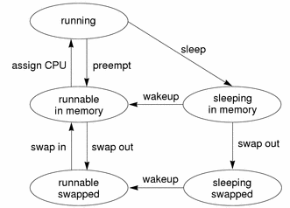
Transition Diagram
Most commonly used
Set of nodes and links
Many ways to display (pg.179-180)
Text
Link Frequency
State Diagram
Tools to create them (IBM Rational Suite)
Also doesn’t scale well (spaghetti displays)
Replace nodes with screenprints
Ex. 350 screens of a satellite-control system were on 3 walls, 6 modules had different styles
Pros:
Similar to Finite-State-Automata (plenty of research in CS on that)
Can we reach every state?
Is there a way out?
Cons: Difficulty in evaluating
Usability
Visibility
Modularity
Synchronization

Slide 7
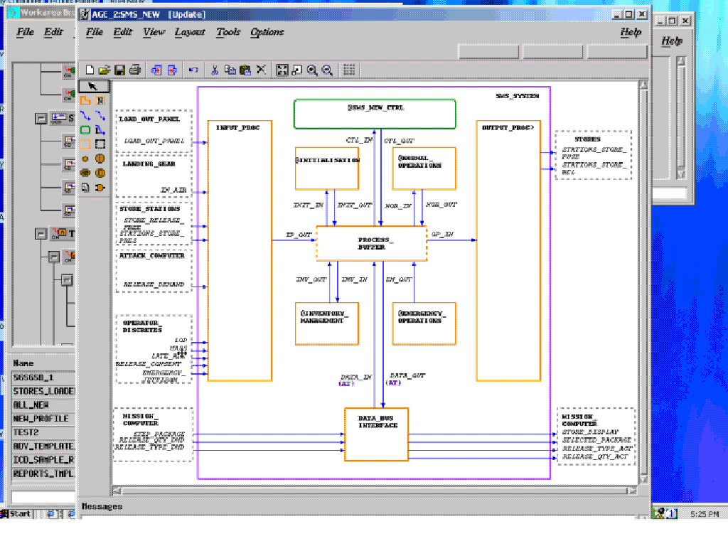
Statecharts
Uses nested roundtangles (pg. 182)
Extensions have been developed for
Concurrency
External events
User Actions
Example: Ilogix’s Statemate
Unified Modeling Language (UML)
Standard for visualizing and documenting software systems
Goal: link specification with interface-building tools
Why is this difficult?
conformity, flexbility

Slide 8
Interface-Building Tools
Previous approaches are better at designing systems, not so much for interfaces
Specification methods help design
Command Languages
Data-Entry Sequences
Widgets
What type of tools would you like to help you build an user interface?

Slide 9
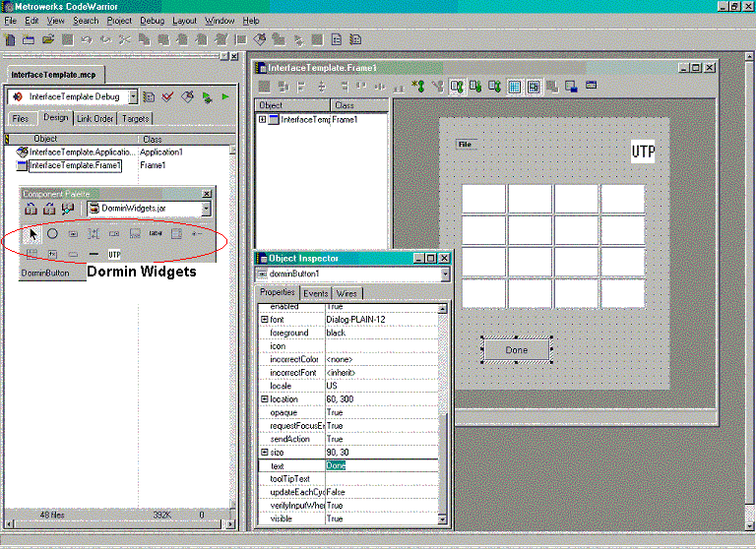
Interface-Building Tools
Tools to do so
Visual editing
Create prototypes
Get the ‘look’ of the system
Pros:
Improve rapidly (with subsequent versions)
Design is fast
Group work, client review, contract work
Modest technical training personnel can design interfaces
Write user manuals from it
Cons:
Non-PC based, makes design tools less prevalent
Overall benefit: user-interface independence – the decoupling of programming from design

Slide 10
Interface Mockup Tools
Develop a quick sketch of GUI
Early stages
Explore multiple alternatives
Convey to clients
Paper and pencil, word processors, PPT
Examples?
Macromedia Director, Flash MX
Levels of mock up
Still images
Prototype (no help, database, etc.)
Apps: Microsoft Visio, Visual Studio .NET, Borland’s JBuilder (screenshot)
Dramatically reduce design time
Win contracts
Comes with supplied widgets
Extensibility is varied

Slide 11
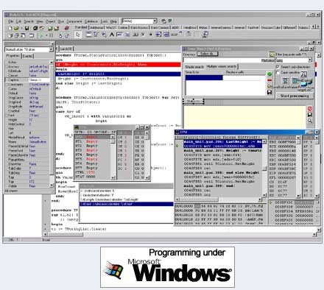
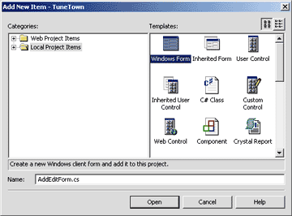
Software-Engineering Tools
Let’s look at Table 5.1 (pg. 190)
Layer 1 – Windowing System
Extensive programming
Most Extensibility
Windows GDI
Layer 2- GUI Toolkits
AKA Rapid Prototyper, Rapid Application Developer, User Interface Builder, UI Dev. Environment
Software Libraries, widgets
Comes w/ basic widgets – scrollbars, buttons, etc.
Requires extensive programming

Slide 12
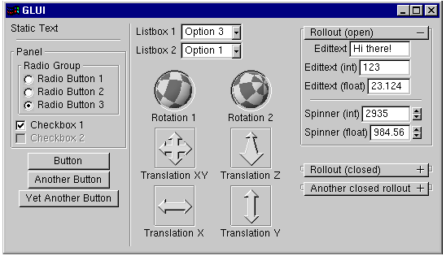
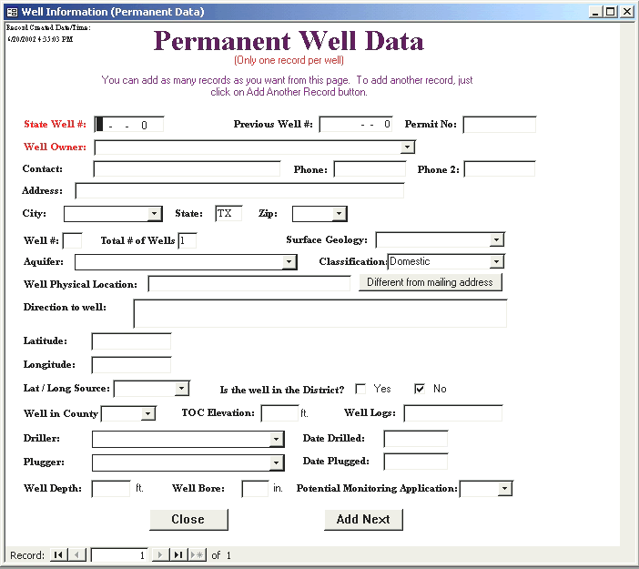
Software-Engineering Tools
Layer 3 - Specialized Languages
No support for nongraphics part
Visual Programming
Simple Scripting
MFC, GLUI, Visual Studio, Tcl/Tk, Qt
Layer 4 – Application Layer
Interface Generators
User-Interface Management Systems
Model-Based Building Tools
Small class of applications
Access, Sybase PowerDesigner

Slide 13
Choosing a Layer
Which is best? Highest or lowest?
Highest is typically better
Less flexibility, quicker design
Ex. pre-fab houses
Six evaluation criteria
Part of the application built using the tool
Ex. Presentation, UI, low-level interaction, other devices
Learning time
Building time
Methodology imposed or advised
Ex. Build UI first, connectivity requirements
Communication with other subsystems
Ex. Databases, devices, web
Extensibility and modularity
Ex. Evolution, new platforms, console games

Slide 14
Considerations
Tool price is usually not one
Good usability
Quote: Usability has been treated by many software architects as a problem in modifiability
Separated user interface from internal functions
Now standard practice
Negatives: Postpones usability till the end!
How does this hurt?
Some problems can not be fixed at the end
Some functions need to be considered from the beginning. Ex. undo a command, progress bar

Slide 15
Windowing-System Layer
UI Building tools, X, MFCs, etc. are typically hard to come by for most new or few-user based systems
New Platform, new tool learning (UNIX, Windows, XBOX, mobile phones)
Most are at its core, basic event based display examples
High-level tools abstract this low-level interface
Creating a window w/ XLib = 237 lines, Tcl/Tk = 2. Also Windows MFC vs Glut.
But what do you give up?

Slide 16
GUI Toolkit Layer
User-interface library
Common widgets
windows, scroll bars, menus, fields, buttons, etc.
Example: MFCs, Xtk, Apple Toolkit, FrontPage
Is it interactive?
Yes: Much more effective
No: More learning, maintenance difficult

Slide 17
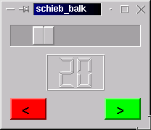
GUI Toolkit Layer
Qt is becoming very popular (freeware)
Crossplatform GUI with a visual editor
OOP C/C++ libraries
Good trade-off? Software engineering skill vs. flexibility vs. creativity vs. features
http://www.suse.co.uk/uk/private/support/online_help/howto/qt/
Sun’s Java
Write once, run many platforms
Java Runtime Environment
JBuilder, NetBeans
Platform versions still look different (font, resolutions, etc.)
Applications to standardize multiplatforms
Sun’s Swing app
IBM Standard Widget Toolkit

Slide 18
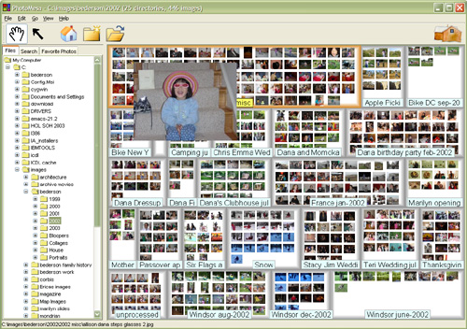
GUI Toolkit Layer
Microsoft .NET
Integrates large programming libraries
Virtual machine compiler
Network support
Standard GUI Toolkit
Tied to windows
Java/J2EE, C#/.NET
Standard GUIs
Good for novices
Improve productivity and satisfaction
Think post WIMP (Windows, Icons, Menu, and a pointer)
Ex. Jazz and Piccolo (zoomable), SATIN
Specialized toolkits to handle apps like photo managing, 3d, etc.

Slide 19

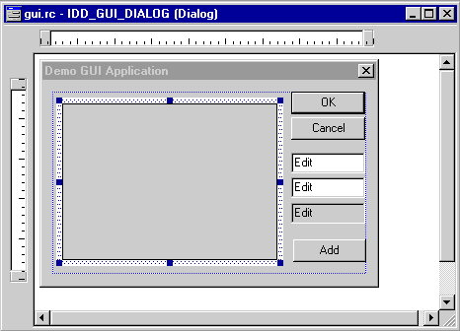
Application Framework/ Specialized Language
Application Frameworks
OOP
Started with MacApp – ’86 toolkit in Object Pascal
All UI have similar structure
Capture it and translate it into classes
Ex. Buttons and actions
Others: NextStep, Cocoa, MFCs
Very effective for rapid UI building
Requires substantial programming skills
Visual tools do exist

Slide 20

Specialized Language
Create a language specifically to create UIs
Ousterhout (’94)
Created a scripting language (Tcl)
Coupled with a toolkit (Tk)
Tcl/tk is one of the most popular UI Languages in use (research)
Combo: Tcl – easy to use, Tk – useful widgets
Interpreted (rapid development)
Cross platform
Lacks visual editor
Good prototyper (hence used in research)
Others include: Perl/Tk, Python/Tk, Visual Basic
Web page interaction
wm title . "Hello" message .m -text "Hello, world!" -font {{Times New Roman} 14} button .b -text "Done" -command exit pack .m .b

Slide 21
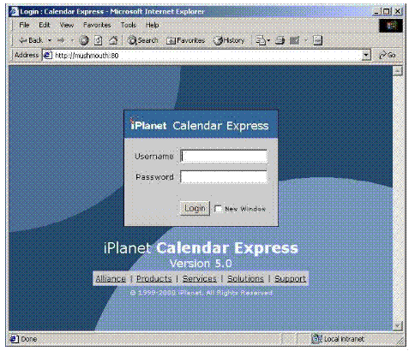
JavaScript
One of the most popular scripting languages
All major web browsers + HTML
Cross platform
Easy to learn (relatively, still requires programming)
Visual editors exist
<SCRIPT LANGUAGE="JavaScript1.2"> window.myMenu = new Menu(); myMenu.addMenuItem("my menu item A"); myMenu.addMenuItem("my menu item B"); myMenu.addMenuItem("my menu item C"); myMenu.addMenuItem("my menu item D"); myMenu.disableDrag = true; myMenu.writeMenus(); </SCRIPT>

Slide 22
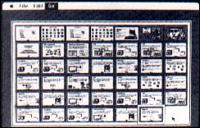
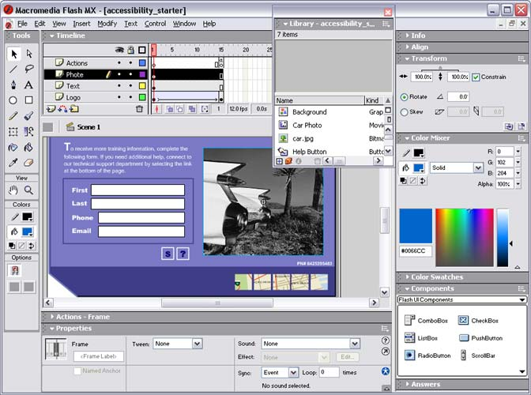
Coupling Visual Editors
Apple HyperCard is the first
Visual Edit the UI (drag and drop widgets)
Auto-create some code
Macromedia Director + LINGO (Script language)
Visual and interactive
Divides UI design from app engineering with a nice interconnect
Other examples: Flash and Flash MX
Visual Programming Tools, the scripting language can be visual.
LabView – function boxes linked with wires
AVS – Image processing
The required flexibility for large scale UI systems are still not supported by most tools

Slide 23
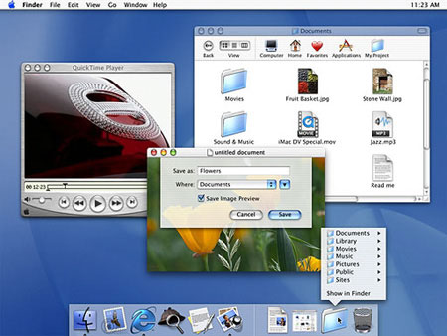
Evaluation and Critiquing Tools
How would you evaluate a UI?
First order
Spelling
Link checking
# of displays
Completeness
Still doesn’t give enough info
Second order
Menu tree depth
Action redundancies
Consistency
Third order
Satisfaction
Task perfromance
What tools could you develop?

Slide 24
Run-time logging software
Capture user activity!
Think about UI design errors, games
Error rates (errors per hour)
Menu Item usage
Help usage
Web-page access (webmasters)
Early example: Tullis’s Display Analysis Program
Took text menus
Reported stats: Upper case %, maximum/ minimum/ average density, complexity
Gave suggestions based on known study results (ex. Lower+Upper is 13% than just Upper)
Hard for GUI
Learn more about how users respond to interfaces
Many user studies run to evaluate effect of font, color, resolution, widgets, etc. on a performance, satisfaction, etc.
Assignment: Everyone go find one and report back in next class. Email the synopsis to TA (due in 1 week)

Slide 25
Evaluation Tools
Pros: If done early, can save substantial development time and cost
Cons: Not many people know how to do it
Simple metrics:
# of widgets to a dialog box
Widget density
Non-widget area
Aspect ratio
Screen balance of UI controls
Still, hard to detect anomalies

Slide 26
Evaluation Tools
List of used colors, word counts, button size checkers, margin checkers can help detect anomalies
Study: Using search + browse + query slowed performance by 10% to 25%
Web page analysis tools exist (ex. Bobby and HTML Tidy)
HTML checker
Similar to a compiler’s lexical analyzer
US NIST has web metrics and tools
WebSAT (static web pages)
WebCAT (tries to categorize the web pages)
WebVIP (instruments web pages to collect stats)

